Slide 1

Security Concepts
Chapter 1
Security Pro

Slide 2
Security Introduction
1.1
Security Concepts
Security Pro

Slide 3
Key Terms
Security operations center (SOC) Development and operations (DevOps) DevSecOps Computer incident response team (CIRT)/computer security incident response team (CSIRT)/computer emergency response team (CERT)
Security Pro

Slide 4
Key Definitions
Security operations center (SOC): The location where security professionals monitor and protect critical information assets in an organization. Development and operations (DevOps): A combination of software development and systems operations and refers to the practice of integrating one discipline with the other.
Security Pro

Slide 5
Key Definitions
DevSecOps: A combination of software development, security operations, and systems operations and refers to the practice of integrating each discipline with the others. Computer incident response team (CIRT)/computer security incident response team (CSIRT)/computer emergency response team (CERT): Team with responsibility for incident response. The CSIRT must have expertise across a number of business domains (IT, HR, legal, and marketing, for instance).
Security Pro

Slide 6
Security Concepts
Security Pro

Slide 7
Security Concepts
Assets Threats Threat agents
Security Pro

Slide 8
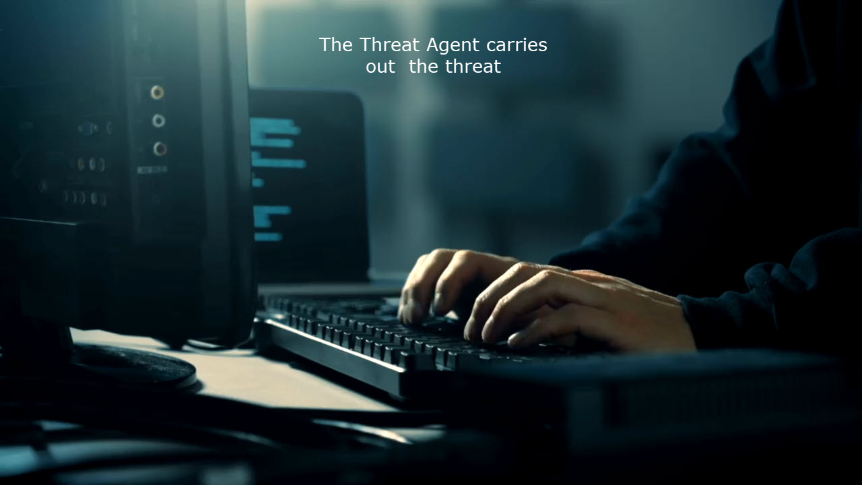
Security Concepts
Security Pro

Slide 9
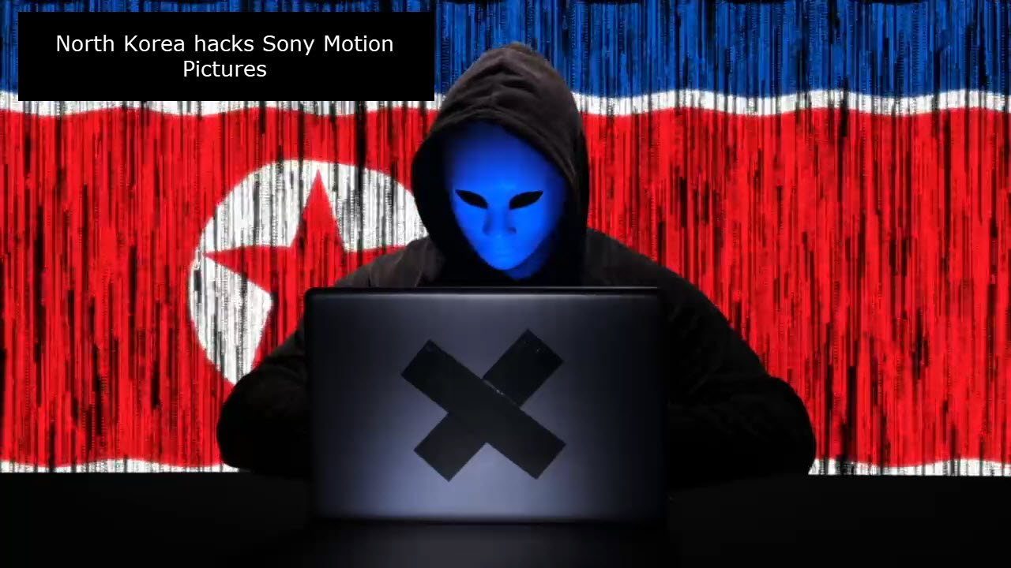
Security Concepts
Security Pro

Slide 10
Security Concepts
Assets Threats Threat agents Vulnerability
Security Pro

Slide 11
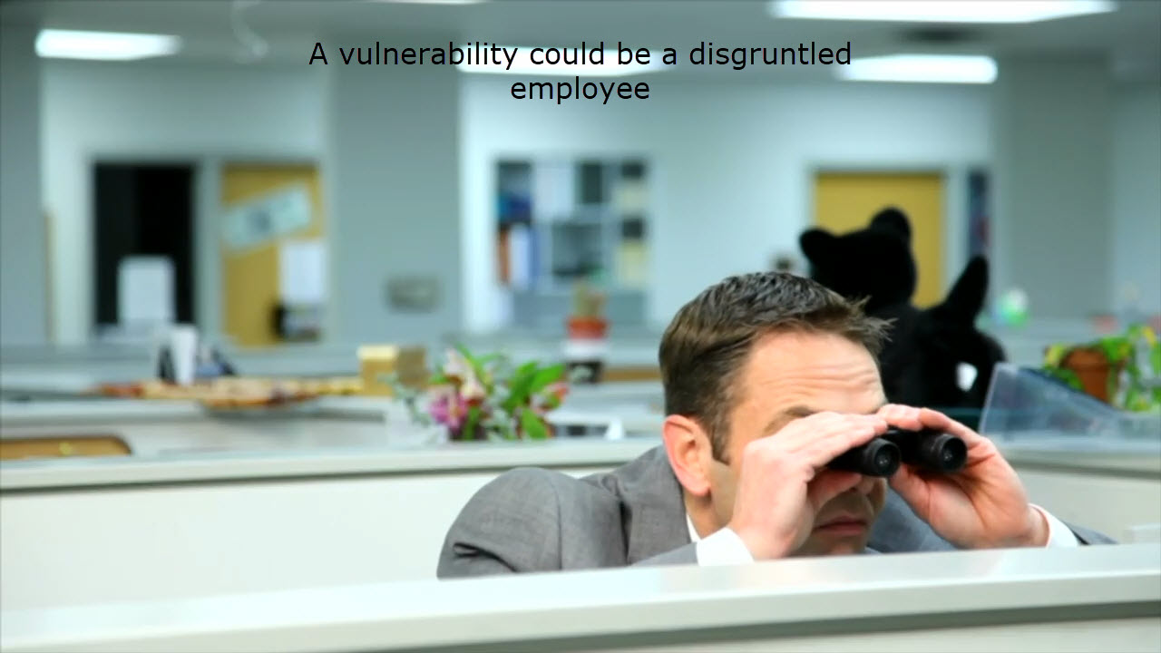
Security Concepts
Security Pro

Slide 12
Security Concepts
Assets Threats Threat agents Vulnerability Exploit
Security Pro

Slide 13
Class Discussion
What is information security? What challenges does a security professional face? What aspects create a proactive approach to security? What is the difference between integrity and non-repudiation? What are the three main goals of the CIA of Security? What are the key components of risk management? What are the three types of threat agents?
Security Pro

Slide 14
Security Controls
1.2
Security Concepts
Security Pro

Slide 15
Key Terms
Security control Managerial Operational Technical Physical Preventive Access control lists (ACLs) Detective Corrective Directive Deterrent Compensating Chief Information Officer (CIO) Chief Technology Officer (CTO) Chief Security Officer (CSO) Information Systems Security Officer (ISSO)
Security Pro

Slide 16
Key Definitions
Security control: A technology or procedure put in place to mitigate vulnerabilities and risk and to ensure the confidentiality, integrity, and availability (CIA) of information. Managerial: A category of security control that provides oversight of information systems. Operational: A category of security control that is implemented by people. Technical: A category of security control that is implemented as a system.
Physical: A category of security control that is implemented by hardware used to deter or detect, such as alarms, gateways, locks, lighting, and security cameras.
Security Pro

Slide 17
Key Definitions
Preventive: A type of security control that acts before an incident to eliminate or reduce the likelihood that an attack can succeed. Access control lists (ACLs): The collection of access control entries (ACEs) that determines which subjects (user accounts, host IP addresses, and so on) are allowed or denied access to the object and the privileges given (read-only, read/write, and so on). Detective: A type of security control that acts during an incident to identify or record that it is happening. Corrective: A type of security control that acts after an incident to eliminate or minimize its impact. Directive: A type of control that enforces a rule of behavior through a policy or contract.
Security Pro

Slide 18
Key Definitions
Deterrent: A type of security control that discourages intrusion attempts. Compensating: A security measure that takes on risk mitigation when a primary control fails or cannot completely meet expectations. Chief Information Officer (CIO): A company officer with the primary responsibility of managing information technology assets and procedures. Chief Technology Officer (CTO): A company officer with the primary role of making effective use of new and emerging computing platforms and innovations. Chief Security Officer (CSO): Typically, the job title of the person with overall responsibility for information assurance and systems security. Information Systems Security Officer (ISSO): Organizational role with technical responsibilities for implementation of security policies, frameworks, and controls.
Security Pro

Slide 19
Control Categories and Types
Security Pro

Slide 20
Managerial
Management-based techniques Policies, procedures, DRP, BCP Written plans
Security Pro

Slide 21
Operational
Performed every day Monitored function checks Visitor controls
Security Pro

Slide 22
Technical
Software and applications Network security appliances IDS/IPS Access control apps ASAs
Security Pro

Slide 23
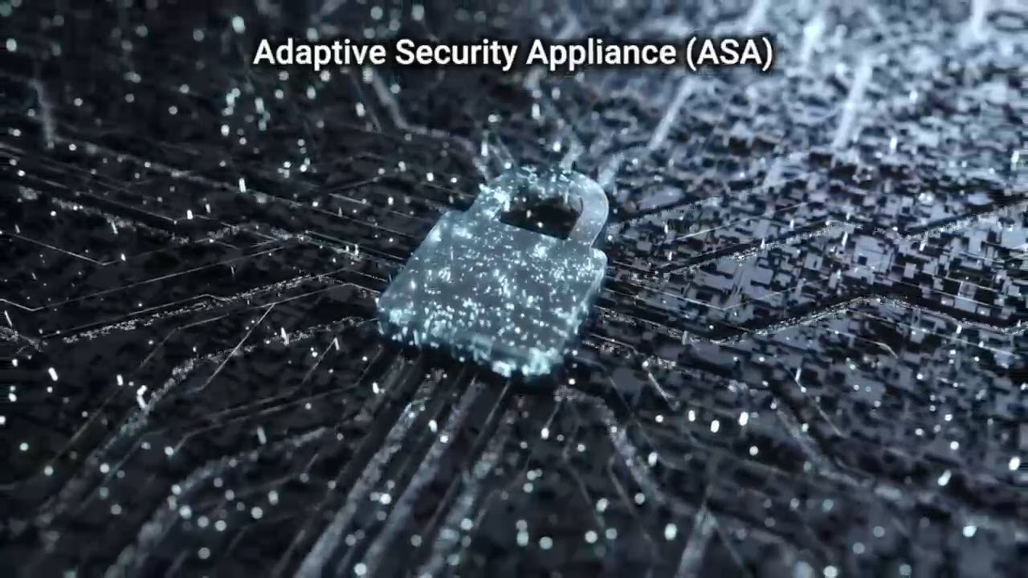
Control Categories and Types
Security Pro

Slide 24
Detective
Alerts team to events Provides various logs Monitors applications
Security Pro

Slide 25
Corrective
Fixes event damage Works during and after IPS intercepts data Uses endpoint protection
Security Pro

Slide 26

Control Categories and Types
Security Pro

Slide 27
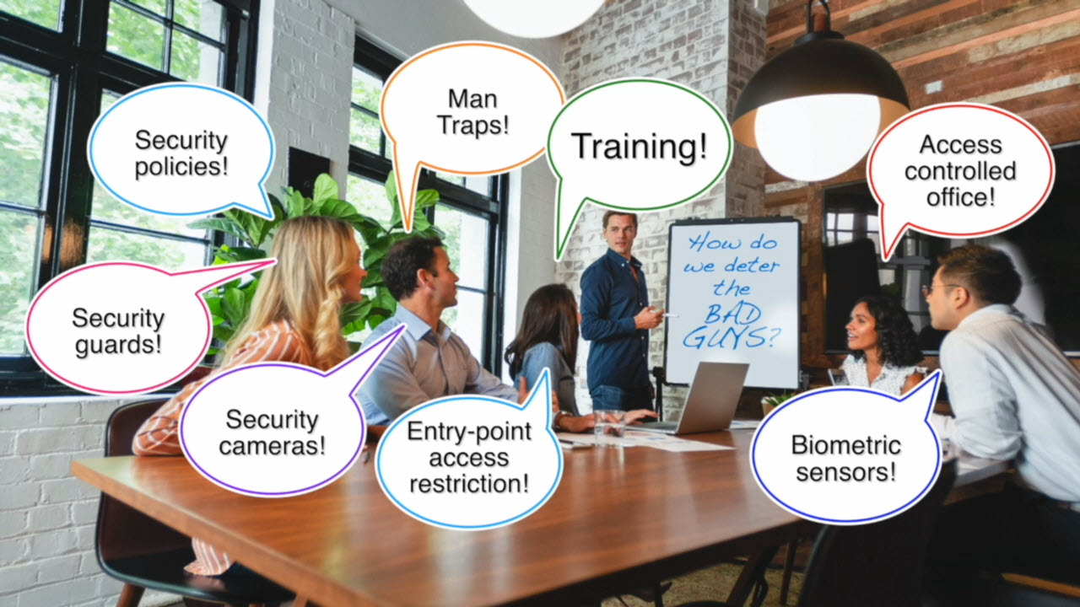
Control Categories and Types
Security Pro

Slide 28
Compensating
Corrects damage Uses data backups Gets servers online fast
Security Pro

Slide 29
Physical
Stops unauthorized access Locked doors Proximity cards Fences, cameras, guards Device management
Security Pro

Slide 30
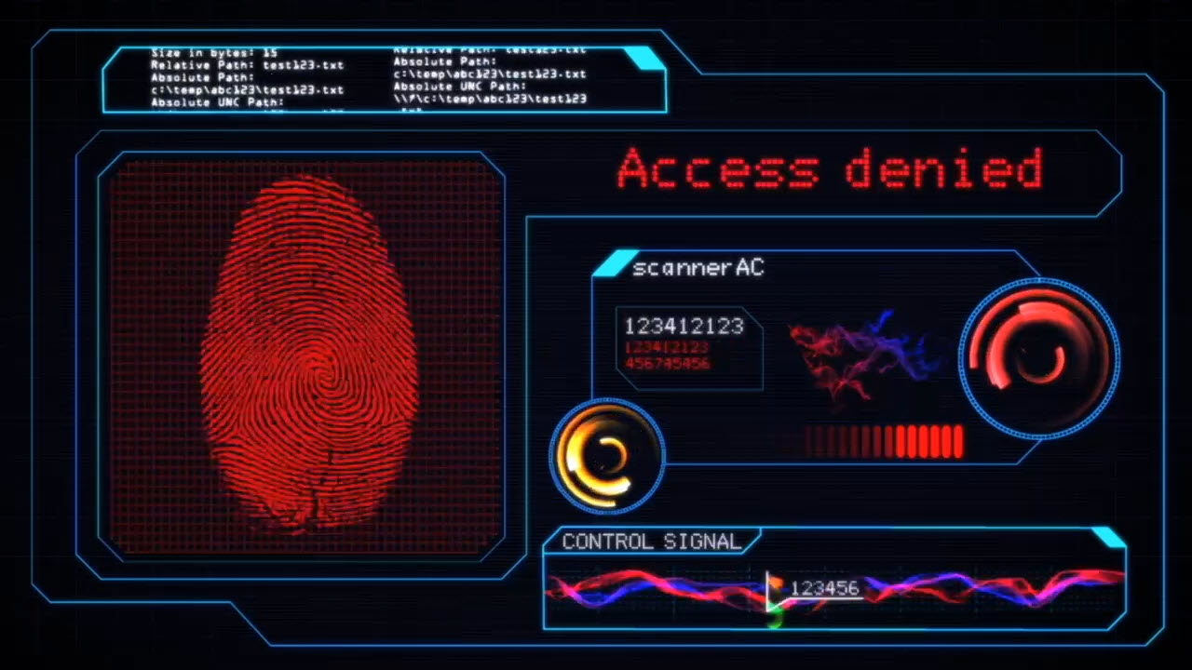
Control Categories and Types
Security Pro

Slide 31
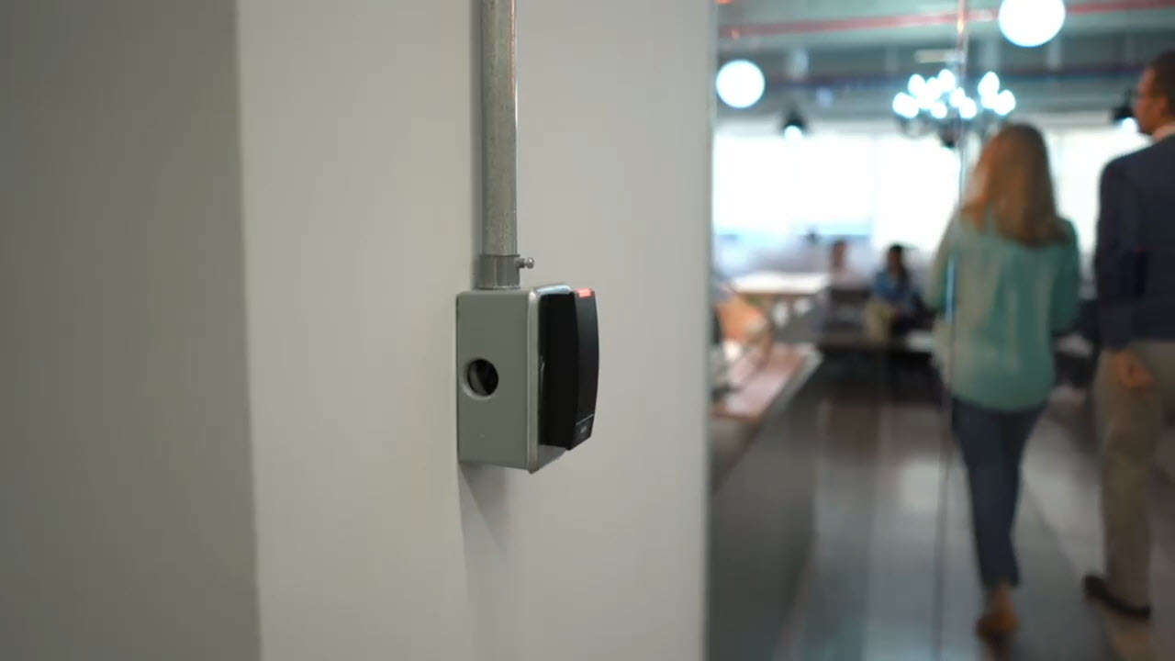
Control Categories and Types
Security Pro

Slide 32

Control Categories and Types
Security Pro

Slide 33
Summary
Categories Security controls Help create a secure network
Security Pro

Slide 34
Class Discussion
What are the three types of control categories? What are preventative controls? What is the difference between corrective and compensating controls?
Security Pro

